Slide 1
Foundation Skills
ACTIVE READING
Occasionally you will see the word CLICK in the PowerPoint. If you are in Slideshow Mode, you can click and see the animations that have been built into this PowerPoint. Slideshow Mode is recommended.

Slide 2
Put this PowerPoint in slideshow mode and click on the active reading skill you wish to learn more about:
Active Reading
Response Starters
Color Coding
Text Coding
Circle One, Underline a Few
Quotation Response
Text Features
Types of Elaborations
Vocabulary
Reading Big 6

Slide 3
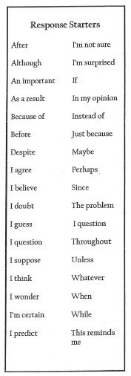
Response Starters
Response starters structure your thoughts using key ideas and phrases to help you have a conversation with the author and think deeply about the text
When using the response starter strategy, you can look to the active reading bookmark on your resource sheet to help guide your responses to the text
For instance, some of your responses may be connections to the text, some may be questions, and some responses may be summarizing a section of the text.

Slide 4
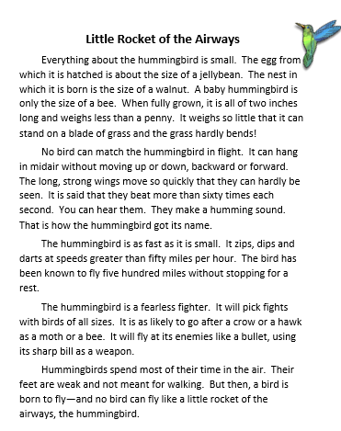
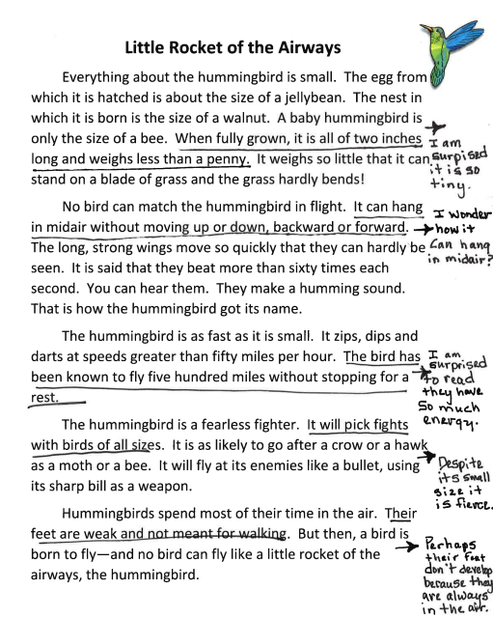
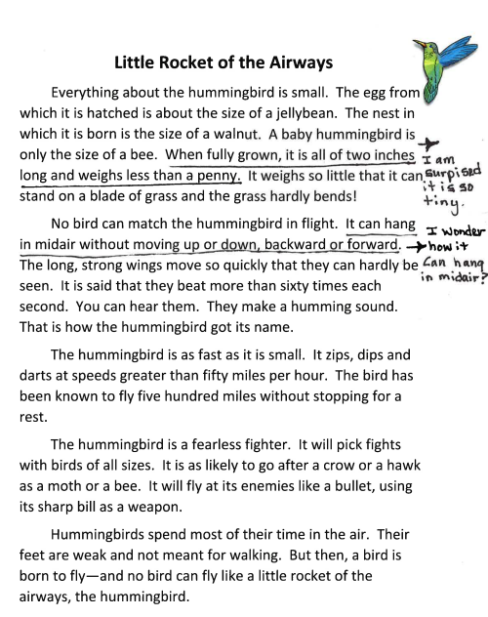
EXAMPLE
(click when prompted):
After completing a cold read of any given text, reread using the response starter strategy. Use a variety of starters to respond to the text. CLICK
The number of responses could be determined by text complexity and purpose for reading. CLICK

Slide 5
Response Starters
To sum up:
Response starters provide readers with a framework that encourages interaction with and high level thinking about text. The response starter strategy is one way we can actively read text.
Click to return home to the Foundation Skills for Active Reading

Slide 6
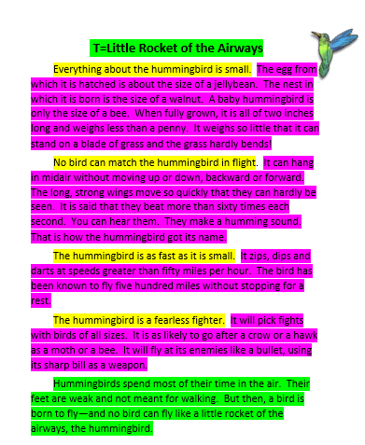
Color Coding
Title/Topic/Introduction/Claim
Key Ideas/Transitions
Details/Elaborations
Conclusion
The color green CLICK identifies titles, topics, claims, introductions and conclusions. In this piece I have highlighted the topic, or T is equal to Little Rocket of the Airways and the concluding paragraph green. NOT ALL TEXT WILL HAVE BOTH AN INTRO AND CONCLUSION! Do not assume!
The color yellow CLICK illustrates key ideas and transitions. On this sample, these key ideas are at the beginning of every paragraph.
The color red (or pink) CLICK shows the details or elaborations. The color pink that highlights the majority of every paragraph shows where the details or elaborations are located.

Slide 7
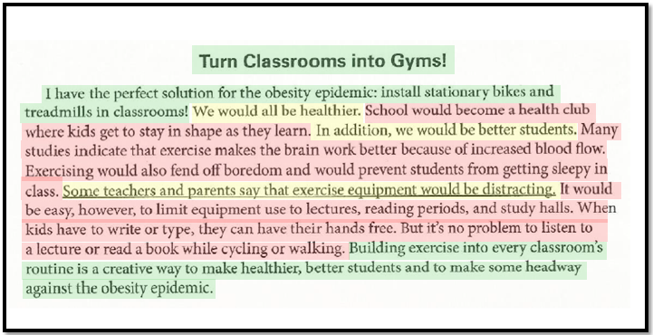
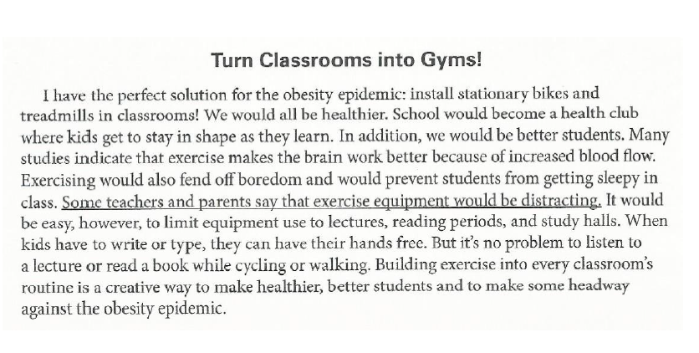
How would you highlight this paragraph? Click to see the answer.

Slide 8
To sum up:
Color coding is a visual strategy that allows you to demonstrate your understanding of the different pieces of text by assigning each color to a purpose of a paragraph or essay.
Click to return home to the Foundation Skills for Active Reading

Slide 9
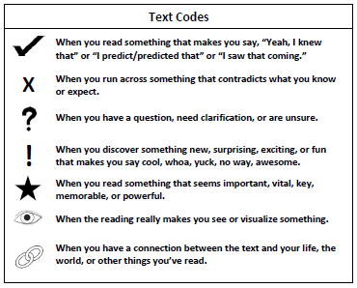
Text Coding
Text coding structures your thoughts using key ideas and phrases to have a conversation with the author and think deeply about the text.
Text Coding is designed to help you to be a reflective reader, pausing and weighing what you are reading against prior knowledge. It also increases your interaction with the text as you engage in self-questioning as you read.

Slide 10
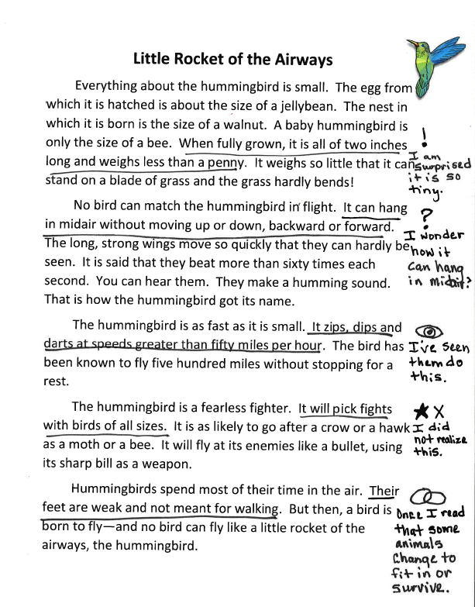
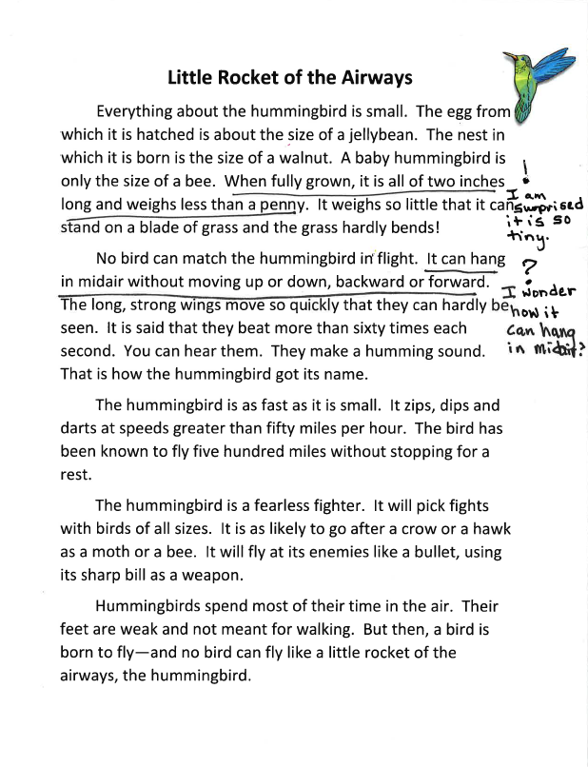
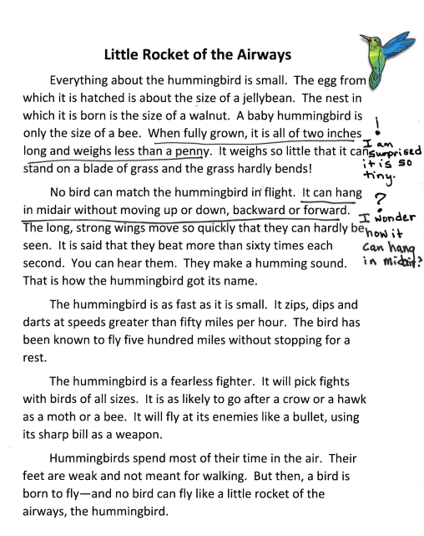
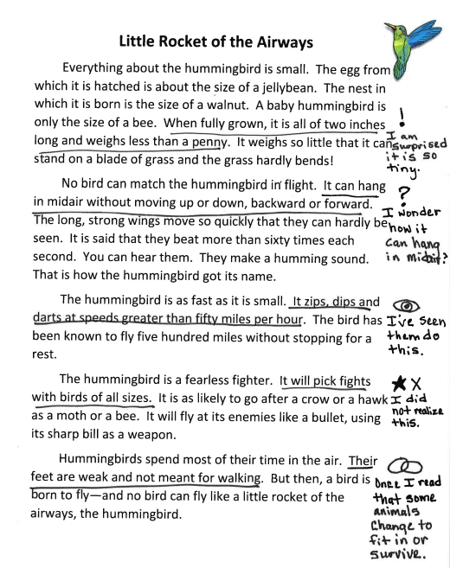
Example
When using the text coding strategy, FIRST underline the specific portion of the text you are responding to. USING THE TEXT CODE KEY, Code the text in the margin and provide a rationale for the code. CLICK For example… when I read in the first paragraph “when fully grown, it is all of two inches long and weighs less than a penny”. I am surprised that hummingbirds are so tiny. Because this is surprising to me, I would code this detail using an exclamation mark and include my rationale for the code.
By coding the text in multiple places, CLICK we can interact with a text from the beginning to the end.

Slide 11
To sum up:
Text coding is the use of symbols to show understanding about a text.
Click to return home to the Foundation Skills for Active Reading

Slide 12
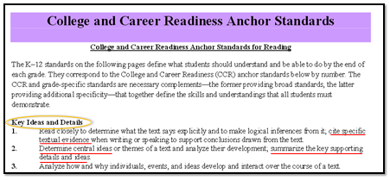
Circle One, Underline a Few
Circle one, underline a few is about finding the main idea. More importantly it is about identifiying the significant and supporting details. Again, this strategy layers the writing to make the author’s thinking visible and eventually transfers into your writing. Good writers stand on the shoulders of other good writers. For example, you need to be able to identify layered writing before you can layer your own.

Slide 13
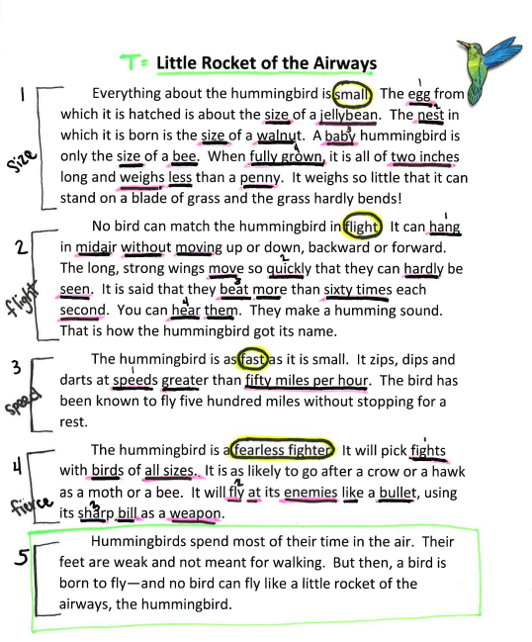
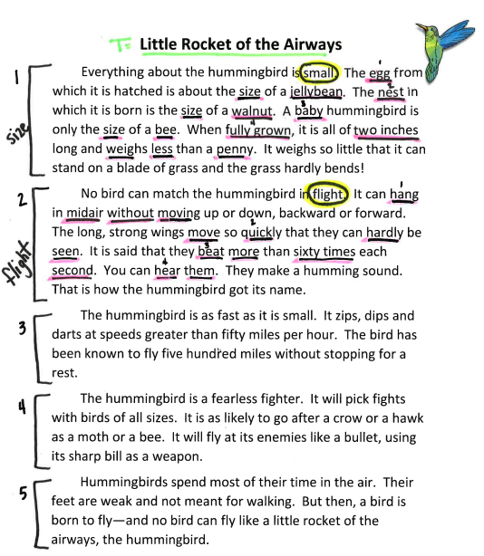
Steps:
Chunk the text into smaller sections. CLICK Because introduction and conclusion paragraphs are focused on the topic itself and do not have a main idea, this strategy does not work on these two paragraphs. REMEMBER not all text will have an intro and/or conclusion. CLICK A good place to start is to chunk the text by paragraphs and number the paragraphs.
As you read, rename each chunk you created. CLICK
Each chunk should only have one key idea and should relate to the name you gave it. Circle the key idea in each chunk. CLICK to continue…

Slide 14
4. The significant details for each key idea are underlined in the text. CLICK Be sure that only significant details, details that directly support the key idea, are underlined. For instance, in chunk 1, size, some of the details that directly support the key idea, small, are egg size of jellybean, nest size of walnut, and baby size of bee. You may be tempted to underline supporting details, or details that directly support the significant details, but this strategy is called underline a FEW, not a lot. CLICK For instance, when the text says it weighs so little that it barely bends a blade of grass, this is a supporting detail that supports weight, and would not be underlined. Be sure you are thinking critically about the details you underline and are limit yourself to 3-4 details.

Slide 15
To sum up:
Circle One Underline a Few uses yellow circles to identify key ideas and pink or red underlines to identify significant details. This strategy is beneficial when you are studying information for an assessment. When revisiting a text for information, you only have to review the information you already analyzed.
Click to return home to the Foundation Skills for Active Reading

Slide 16
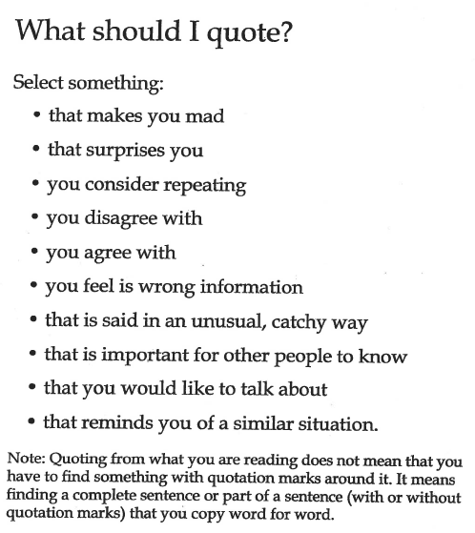
Quotation Response
When using this strategy, you should select quotations from the text that generate some response in your mind as you read.
These prompts encourage you to select quotations that generate some emotion, CLICK such as anger or surprise, as well as quotations that connect to your background knowledge CLICK such as quotations you agree or disagree with.
It is important to note CLICK that when you are quoting from what you are reading, it does not mean that you have to find something with quotation marks already around it. It means finding a complete sentence or part of a sentence with or without quotation marks that you copy word for word.

Slide 17
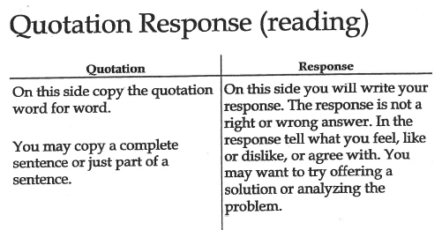
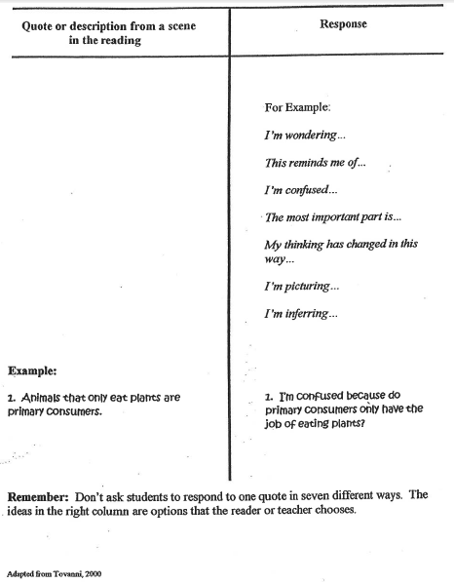
1. Create a t-chart on your paper, labeling the left side CLICK “Quotation” and the right side CLICK “Response”. CLICK
2. Copy the quotation word for word on the left side of the chart. CLICK You may copy the entire quotation, or just a specific part of the quotation. On the right, CLICK respond to the quote. Remember, there is not a right or wrong answer. CLICK Instead, your response should tell what your feel, like or dislike, or agree with. You could also offer a solution or analyze the problem. CLICK Use the prompts provided to help get you started!

Slide 18
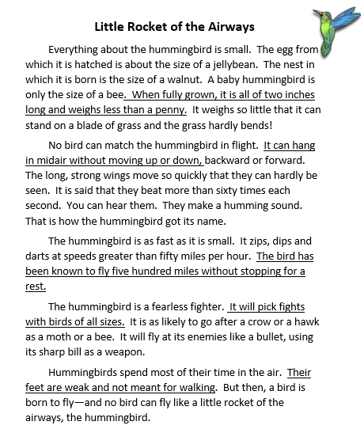
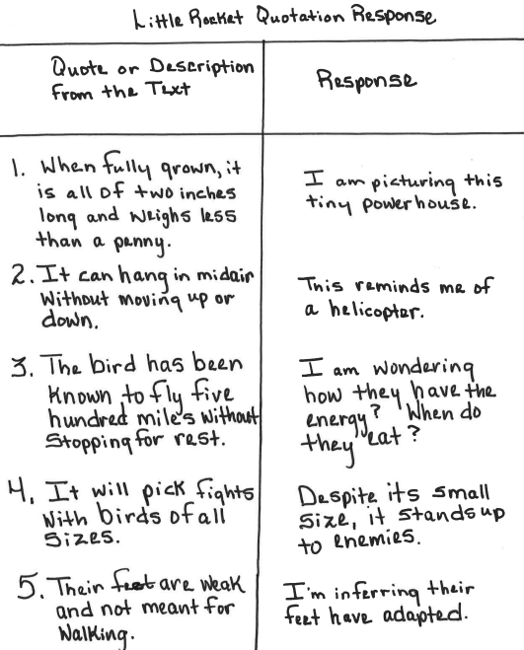
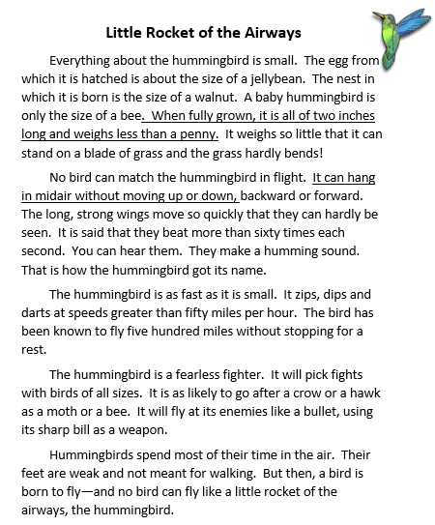
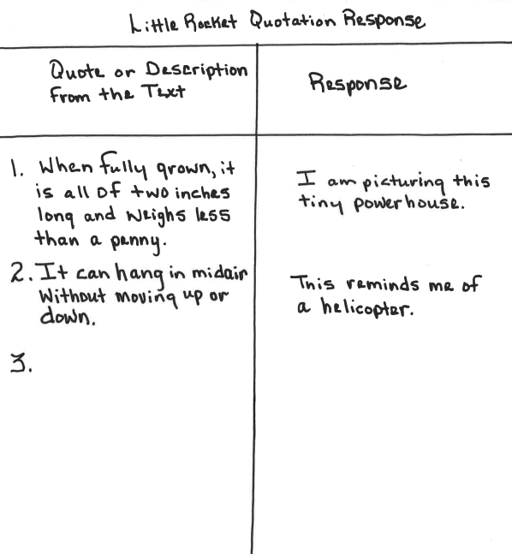
EXAMPLE:
I first created my T chart on my page. When reading the text, I am looking for evidence that generates a response in my mind. To do this, I need to be thinking about what it is I am reading. For instance, when I read the sentence, when fully grown, it is all of two inches long and weighs less than a penny, this creates a picture in my mind. CLICK I would copy this quotation on the left side of my t-chart, and respond to this quotation by saying “I am picturing this tiny powerhouse. CLICK When I read it can hang in midair without moving up or down, I am reminded of a helicopter. CLICK I would copy the quotation on the left of my t-chart, and write my response on the right. CLICK
CLICK Be sure to identify and respond to quotes from the beginning through to the end.

Slide 19
To sum up:
When using the quotation response strategy, you need to focus on your response because this strategy is a way for your to communicate your understanding of what you read, and also as a way for you to practice elaborating on text evidence in your writing.
Click to return home to the Foundation Skills for Active Reading

Slide 20
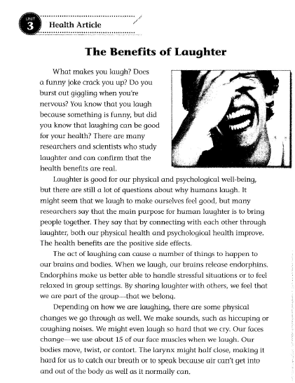
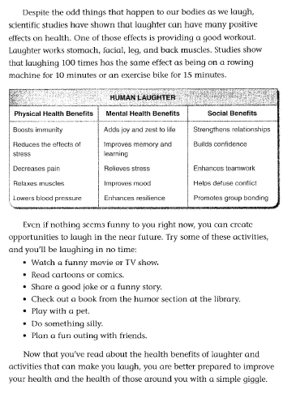
Text Features
In the article, The Benefits of Laughter, several text features can be identified. One type of text feature are bullets CLICK. A purpose bullets serve in this text is to list information. CLICK The chart CLICK in the article is another and is attached to the purpose of classifying information. CLICK Another feature identified in this article is the title CLICK. Titles give the text focus and clarity. CLICK
**By identifying how and why authors use text features and elaborations in their text, you can stand on the shoulders of these authors and apply the same skill to your own writing.**

Slide 21
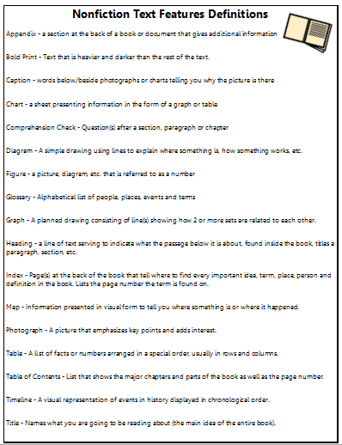
Using the Nonfiction Text Feature Definition card what text features can you identify in Little Rocket of the Airways?
For instance, I see a photograph CLICK which helps the reader to create a picture in their mind about what it is they are reading. Pictures can emphasize key points while adding interest at the same time. CLICK
Another text feature I see is the title. CLICK Titles provide direction to the reader as to what the text will primarily be about. Titles relate to the topic or main idea of the whole text.
Title
Photograph
TIP: Use the definitions to help you identify the purpose of the text feature!
Notes:
Identifying text features within a text is a great prereading strategy that allows students to gather information about what the text might be about before they read. Getting students to identify the purpose behind the feature, or why the author included the text feature in their text not only encourages higher level thinking processes, but helps students to include text features in their own writing, addressing common core state standard writing number 2.
Your Nonfiction Text Feature Definition card includes a variety of text features. Their definitions can be used to help guide you to identifying the pruose they are serving in a piece of writing. Using this handout, I can identify text features included in the article “Little Rocket of the Airways”.
For instance, I see a photograph CLICK which helps the reader to create a picture in their mind about what it is they are reading. Pictures can emphasize key points while adding interest at the same time. CLICK
Another text feature I see is the title. CLICK Titles provide direction to the reader as to what the text will primarily be about. Titles relate to the topic or main idea of the whole text.

Slide 22
To sum up:
Text Features fulfill a specific role within the text. In other words, authors use text features with a specific intention. A reader’s ability to identify the role the text feature is fulfilling is what makes the feature effective.
By identifying and analyzing specific text features that are used within a piece of text, you are better able to include them in your own writing.
Click to return home to the Foundation Skills for Active Reading

Slide 23
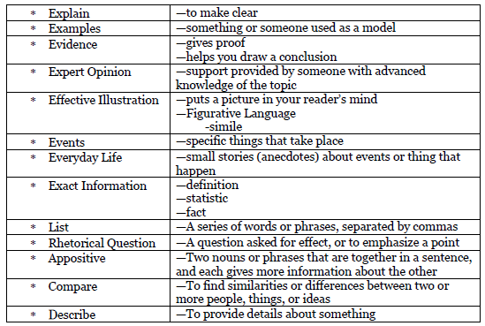
Elaborations
* Cause and Effect | - To note a relationship between actions or events such that one or more are the result of the other or others
Elaborations make up the meat of the writing. When you identify the details in the text, both significant and supporting, you are identifying elaborations. This particular foundation skill is not focusing on whether or not you can identify elaborations, but rather that they can name the elaborations you identified. By naming specific types of elaborations in a text, you show you understand the purpose of the elaboration itself. Understanding the purpose of the types of elaborations is necessary when you need to incorporate elaborations into your own writing.

Slide 24
* Cause and Effect | - To note a relationship between actions or events such that one or more are the result of the other or others
CLICK to see all of the elaborations I identified and named (I named 6!)…Try to name them before you see my answer. Would you name any differently? There is usually more than 1 right answer! Just be able to defend your decision!

Slide 25
To sum up:
Elaborations are made up of significant and supporting details in a text. Details can be considered several different types of elaborations. The strength in this strategy rests in the justification of the elaboration type identified. When you can justify which type of elaboration fits the detail the best, you have mastered this strategy!
Click to return home to the Foundation Skills for Active Reading

Slide 26
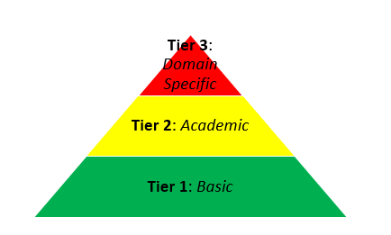
Academic vs Domain Specific
Vocabulary
novel
meal
utensil
prose
cuisine
apparatus
book
food
tool
Tier 3 words are the least common vocabulary words. These words are domain specific, meaning they have only 1 meaning and are used in only one domain.
Tier 2 words are academic vocabulary words. These words have multiple meanings and can be seen in multiple content areas. Also, the meaning of the word is dependent on how the word is being used.
Tier 1 vocabulary words are the most basic of vocabulary words and are the most commonly used.
Click to see how 3 different vocabulary words change as they increase in tier level

Slide 27
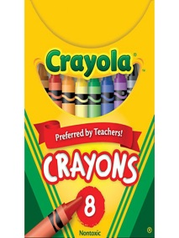
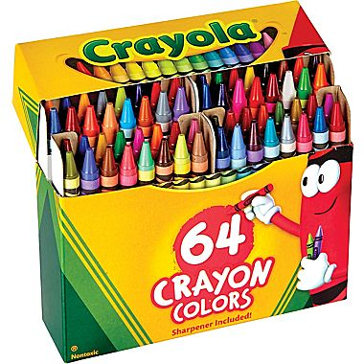
Use this analogy to help you picture the tiers:
Think of the tiers as boxes of crayons.
Which box would make the best picture?
Box of 8: Brown
Box of 64: Sand, Tan, Khaki, Copper
Box of 120:
Almond, Antique Brass,
Beaver, Raw Sienna,
Tumbleweed, Chestnut

Slide 28
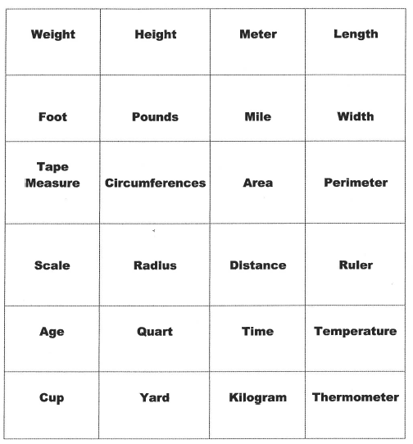
Sorting vocabulary words into tier 2 and 3 categories helps to learn the difference between the two. Identifying upper level vocabulary is the first step toward using it in your own writing! How would you sort these words? Click to see my answers.
Tier 2: Academic Vocabulary |  |  | Tier 3: Domain Specific Vocabulary
Width
Height
Meter
Length
Scale
Radius
Distance
Ruler
Tape Measure
Circumference
Quart
Kilogram
Thermometer
Foot
Pounds
Mile
Width
Age
Time
Temperature
Cup
Yard
Area
Perimeter

Slide 29
To sum up:
Vocabulary words can be sorted into 3 tiers: tier 1 (basic), tier 2 (academic) and tier 3 (domain specific). Your writing needs to reflect a mixture of both tier 2 and tier 3 vocabulary. In order to use tier 2 and 3 vocabulary, you first need to be able to identify tier 2 and tier 3 vocabulary.
Click to return home to the Foundation Skills for Active Reading

Slide 30
Reading Big 6
This is a strategy for answering a READING prompt. There are 6 steps:
Read text; watch/listen to the media
Read (analyze) the prompt using the ST# (star)strategy
Reread the text (close reading) and annotate
Plan/organize your thinking about the text (use a thinking chart – these can be found in the Foundation Skills WRITING PowerPoint)
Write your rough draft using the RACE strategy
Create your final product (write or type)

Slide 31
Read the Text; Watch/listen to Media
Step 1
It is important for you to get an initial exposure to the material and just take in the information. Get a feel for what the topic is and how the text is addressing the topic.

Slide 32
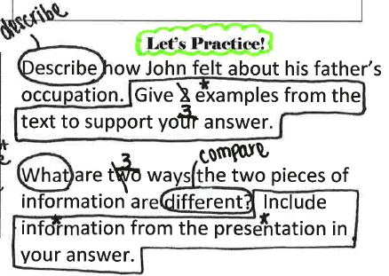
Read/Analyze Prompt – ST# Strategy
Step 2
S – Skill CIRCLE it and rename it!
T – Task BOX it!
# - Number UNDERLINE and add 1 more!
★ - Key Words STAR key words (the what)
EXAMPLES: Do both first on a piece of scratch paper. Then, CLICK to compare your answers with mine!
Describe how John felt about his father’s occupation. Give 2 examples from the text to support your answer.
What are two ways the two pieces of information are different? Include information from the presentation in your answer.

Slide 33
SKILL and TASK Examples
Need help identifying what is a skill and what is a task? Maybe you want to know what the skill means? This table has commonly used examples and will be useful for both!
SKILL | TASK
How (consider, causality, manner, extent, or condition) | Information
Why (supply, cause, reason, intention, or justification) | Details
What (name, make statement of amount or extent or cite evidence to prove a point) | Examples
List (itemize or catalogue; systematic listing) | Main points
Describe (tell a story in detail; organize spatially or chronologically) | Information
 | Evidence
 | Point

Slide 34
Reread the Text (close reading) and Annotate
Step 3
Any of the active reading strategies presented in this power point would be effective for this step. Annotating text means to add an explanatory note to the text that clarifies what the text is saying. Thinking of annotating a text as having a conversation with the author. These annotations should be attached the prompt, specifically the SKILL and the TASK.

Slide 35
Plan/Organize your Thinking About the Text Using a Thinking Chart (more information on thinking charts found in the Foundation Skills Writing PowerPoint)
Step 4
Common Skills MATCHED to Thinking Charts:
NOTE: This is a START and not a comprehensive list!
SKILL | APPLICABLE THINKING CHART(S)
How (consider, causality, manner, extent, or condition) | Flow; Multiflow
Why (supply, cause, reason, intention, or justification) | Flow; Multiflow
What (name, make statement of amount or extent or cite evidence to prove a point) | 2 Column Notes, Tree Chart; T Chart; Discussion Web
List (itemize or catalogue; systematic listing) | 2 Column Notes, Tree chart, T Chart, Discussion Web
Describe (tell a story in detail; organize spatially or chronologically) | BME; Bubble

Slide 36
Write Rough Draft using RACE Strategy
Step 5
Common Skills MATCHED to Thinking Charts:
NOTE: This is a START and not a comprehensive list!
SKILL | APPLICABLE THINKING CHART(S)
How (consider, causality, manner, extent, or condition) | Flow; Multiflow
Why (supply, cause, reason, intention, or justification) | Flow; Multiflow
What (name, make statement of amount or extent or cite evidence to prove a point) | 2 Column Notes, Tree Chart; T Chart; Discussion Web
List (itemize or catalogue; systematic listing) | 2 Column Notes, Tree chart, T Chart, Discussion Web
Describe (tell a story in detail; organize spatially or chronologically) | BME; Bubble

Slide 37
Write Rough Draft using RACE Strategy
Step 5
R – RESTATE the question
A – ANSWER the question
C – CITE evidence and elaborate
E – EXTEND your answer and conclude

Slide 38
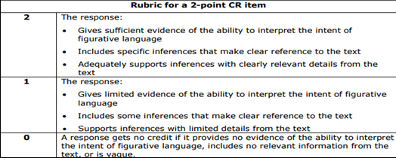
Use the 2 point rubric to grade each of the 3 responses. Then, click to see if your scores match mine!
Example
PROMPT: Explain the meaning and purpose of the metaphor in “little ripples of fun were continually playing on the surface of that current of intense thought and feeling in which her deep, earnest nature flowed.
The author uses a metaphor comparing Catherine’s personality to a river in the passage, “little ripples of fun were continually playing on the surface of that current of intense thought and feeling in which her deep, earnest nature flowed.” Although Catherine was a serious person who had a lot of deep feelings and a good life, when she states, “Don’t remember much about it myself,” it shows that she has a sense of humor because no one remembers much about being born.
1
The author uses a metaphor comparing Catherine’s personality to a river in the passage: “little ripples of fun were continually playing on the surface of that current of intense thought and feeling in which her deep, earnest nature flowed.” The words, “Don’t remember much about it myself,” show that she was funny.
The author uses a metaphor comparing Catherine’s personality to a river in the passage, “little ripples of fun were continually playing on the surface of that current of intense thought and feeling in which her deep, earnest nature flowed.”
2
0

Slide 39
Create your Final Product
Step 6
Take a moment to EDIT and REVISE your draft!
ARMS (Revision Strategy) | CUPS+ (Editing Strategy)
A – ADD sentences and words | C – CAPITALIZATION (sentences, names, places, months, I)
R – REMOVE unneeded words or sentences | U – USAGE (match nouns and verbs correctly)
M – MOVE a sentence or word placement | P – PUNCTUATION (. ! , ; : () “ “)
S – SUBSTITUTE words or sentences for others (vocabulary) | S – SPELLING (check all words; use your resources
 | + - neatness (product is legible and organized)

Slide 40
To sum up:
Reading Big 6 is a strategy that will be especially useful to you in an assessment. When you are taking a reading assessment, use the Reading Big 6 strategy to respond to a reading prompt.
Click to return home to the Foundation Skills for Active Reading

Slide 41
Final Thoughts
If you did not find the answers or help you were looking for, you can
* email me at: Adrienne_culliton@gfps.k12.mt.us or * call me at:
268.6464

