Slide 1
T= CHECKLIST for “Attacking an Argumentative Writing Prompt”

Slide 2
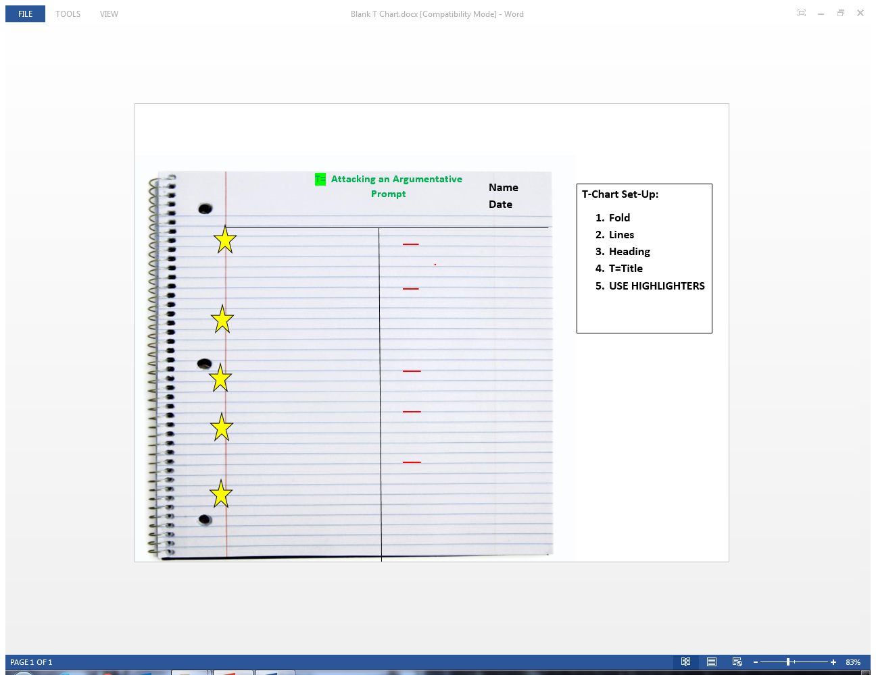
SEVEN STARS for
SEVEN STEPS

Slide 3
Get 5 sheets of paper
Label for TAP+F (Prompt)
Label Plan (Argumentative)
Label Discussion Web (Yes No)

Slide 4
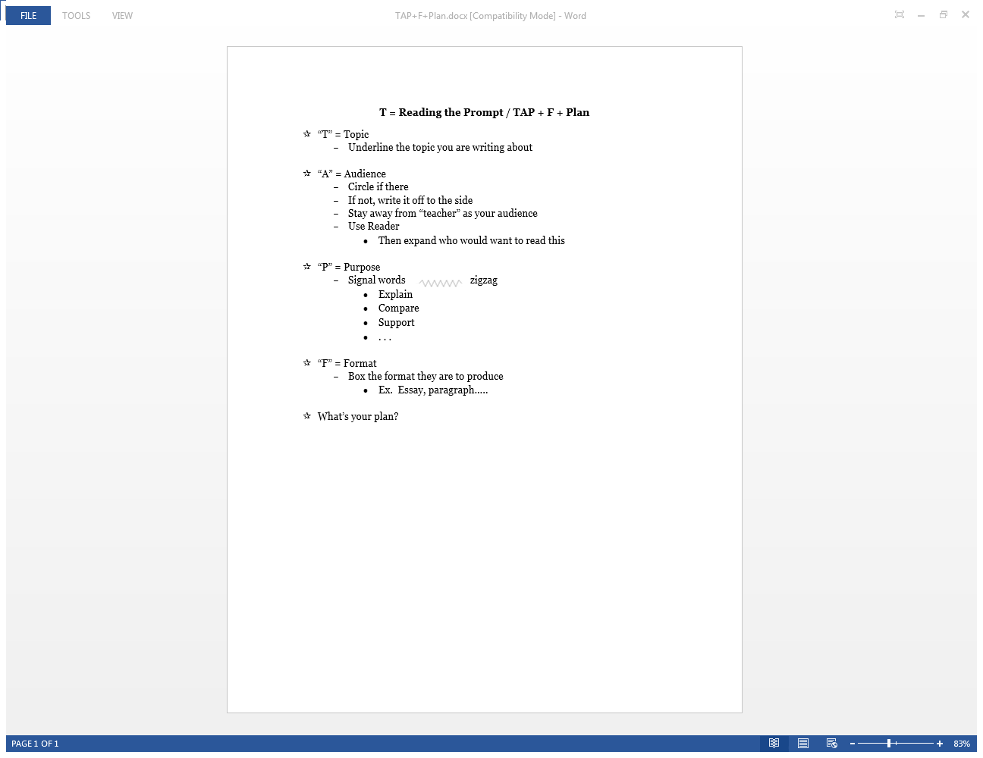
READ THE PROMPT
TAP+F

Slide 5
READ/WATCH/LISTEN
ANNOTATE/TAKE NOTES

Slide 6
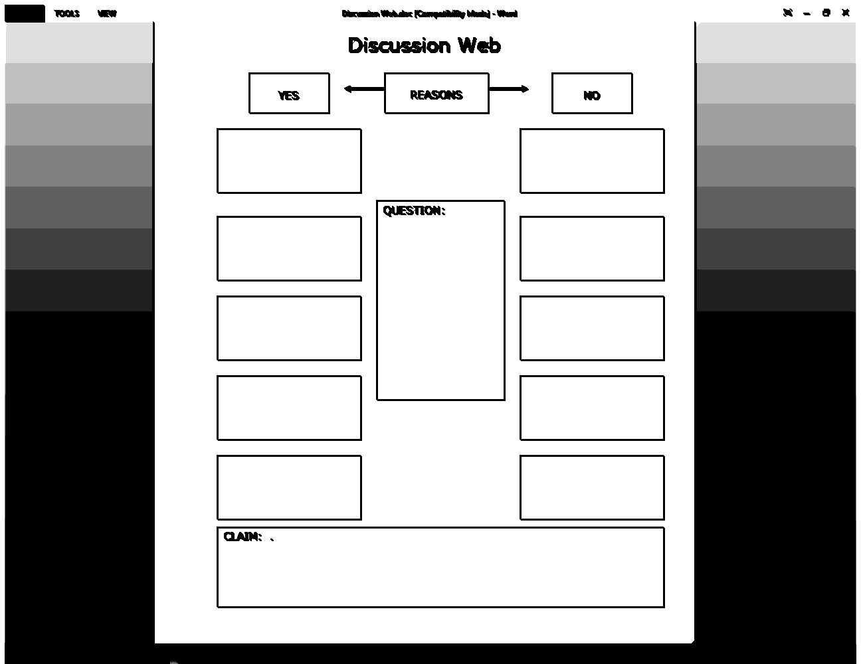
Organize Notes
Discussion Web
Argumentative
Template

Slide 7
Hand Write the DRAFT

Slide 8
TYPE the DRAFT
ALL DONE!!!!!

